Slide 1

English for Telephoning
Class: 18C1-NNA1
Time: 14.10 – 15.40 on
Lecturer: Ms. Nguyen Thi Thanh Tu
Faculty of Foreign Languages
Ly Tu Trong College of Ho Chi Minh City
Unit 3: Let me get back to you on that

Slide 2

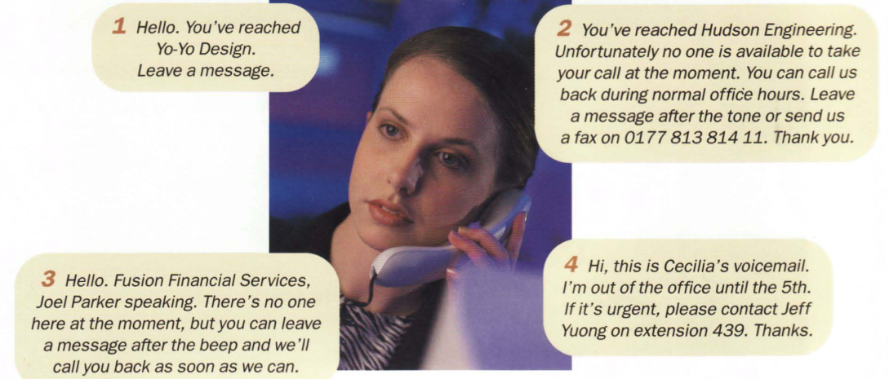

Slide 3
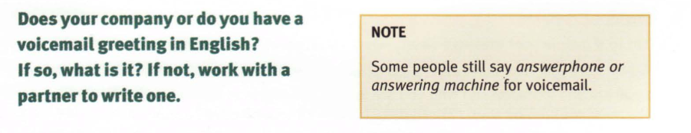

Slide 4
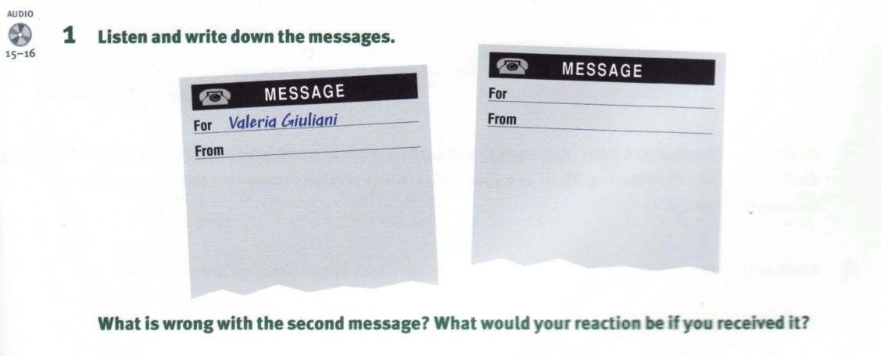

Slide 5
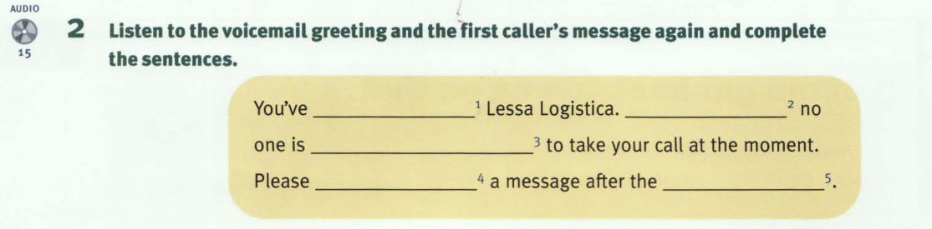
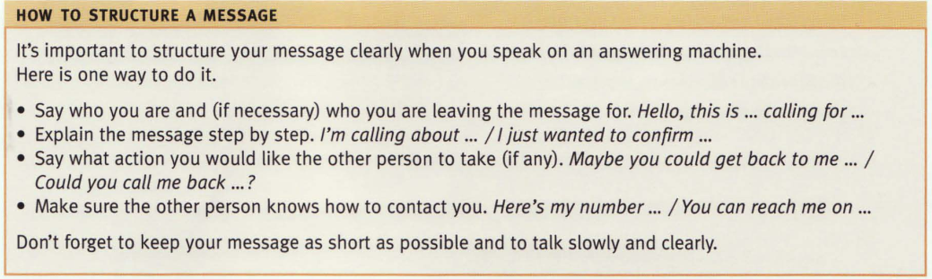

Slide 6
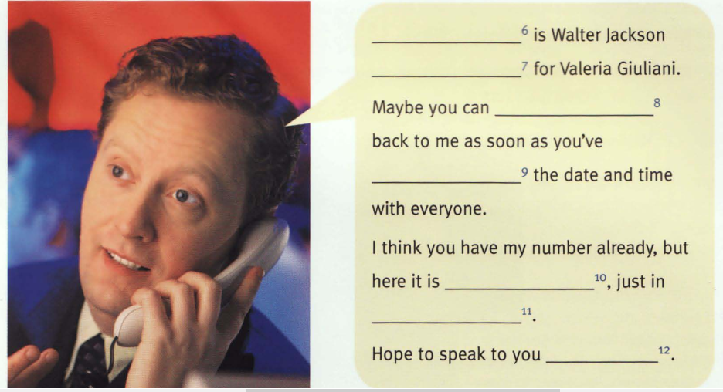

Slide 7
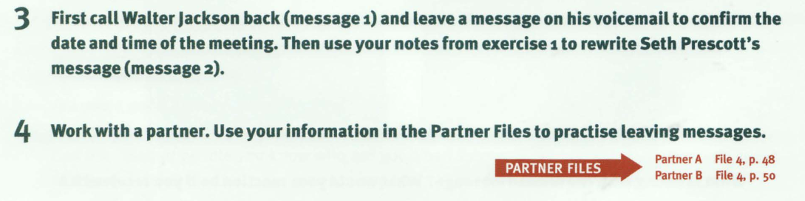

Slide 8
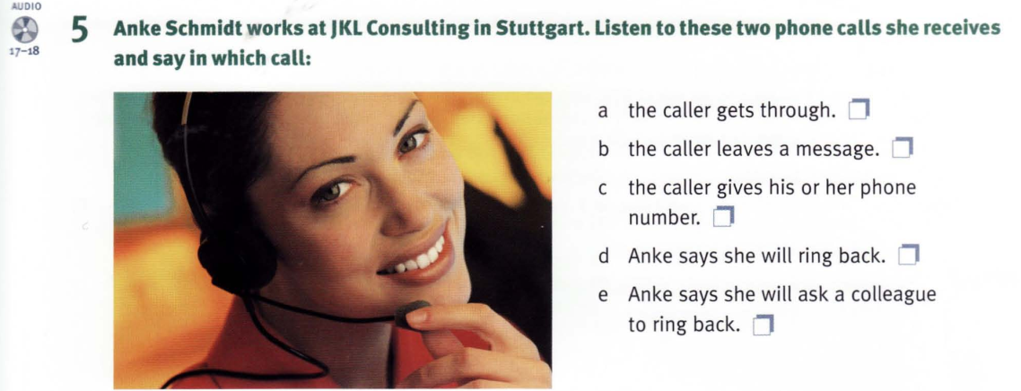

Slide 9
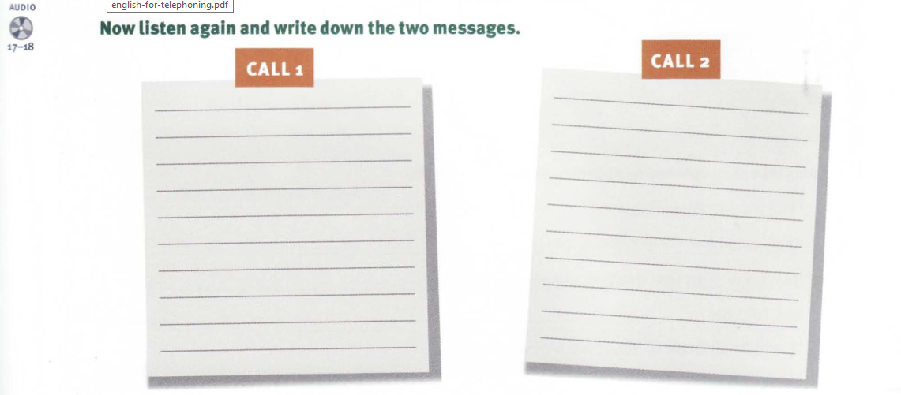

Slide 10
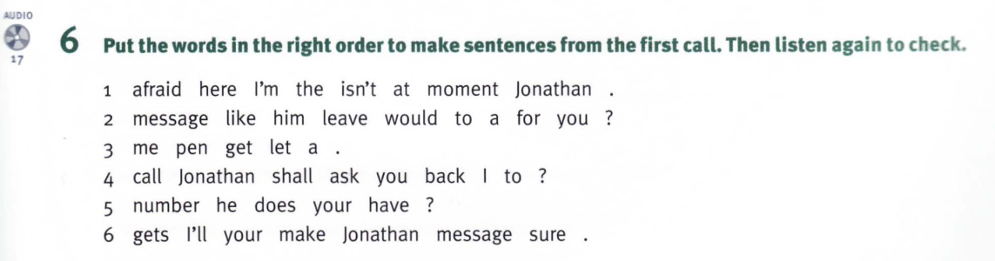

Slide 11
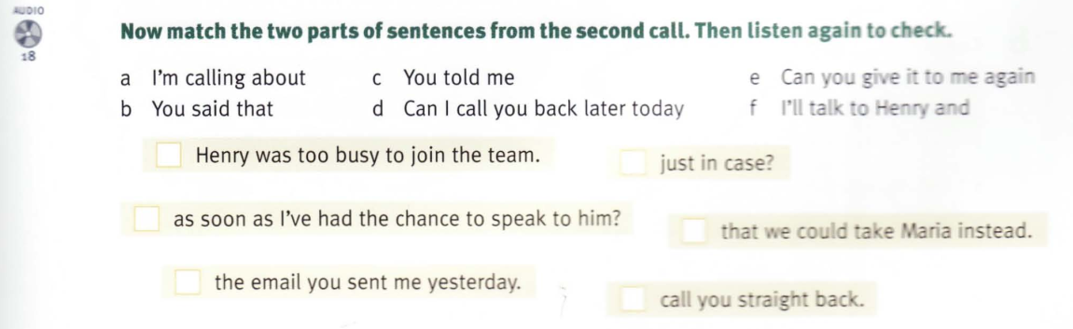

Slide 12
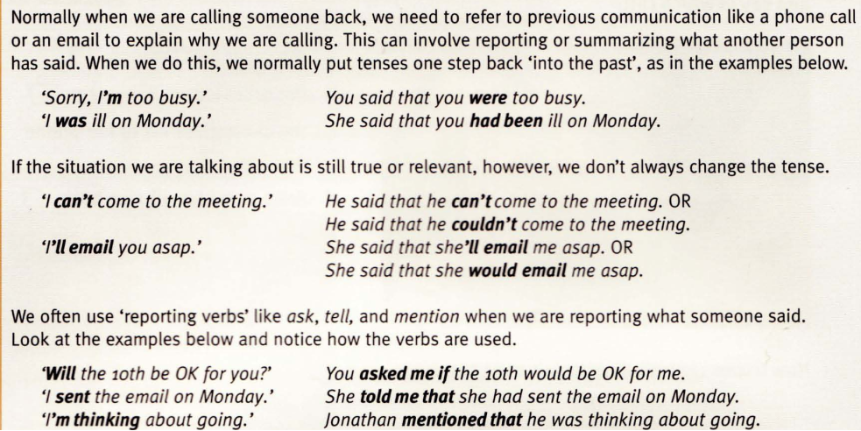
Referring to previous communication

Slide 13
Homework:
After these two periods you have to remember Useful Phrases;
do exercises in the part 6 , and read ‘referring to previous communication’
Prepare for unit 3: (cont.) Let me get back to you on that

